Slide 1
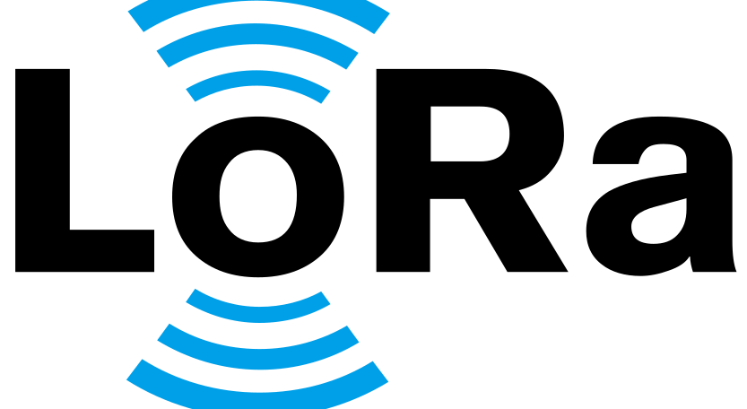
Guy Cohen
301198099

Slide 2
LoRa – Long Range
Lora protocol devloped by cycleo company and acquired by semtech the founding member of the LoRa association.
LoRa (Long Range) is a Low-Power Wide-Area network modulation technique(LPWAN).
Low Power (LP) – Can operate on batteries that are supposed to run at least couple of years.
Low data rate – The data will pass slow and sporadic.
Long range – single gateway or base station can cover entire cities of hundreds of square kilometers.

Slide 3
LoRa
Lora works better in open area than in urban area.
We can improve the range by changing the eight of the antenna (higher is better).
Low data rate (few bytes to kb).

Slide 4
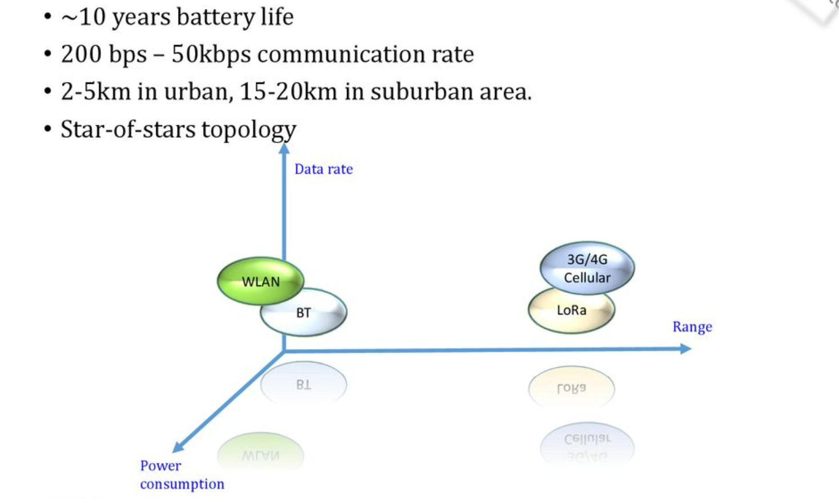
Comparison

Slide 5
LoRa – Long Range
(LPWAN)
Range ~10[km]
Power –> 18-22[mW]
Range and power
Bluetooth
(short range)
10[m]
Power –> 2-3[mW]
3G/4G/5G
(Cellular)
Between 3500[m] – 5000[m]
Power –> 300-600[mW]
Wifi
(short range)
between 30[m]
to 70[m]
Power -> 80-90[mW]

Slide 6
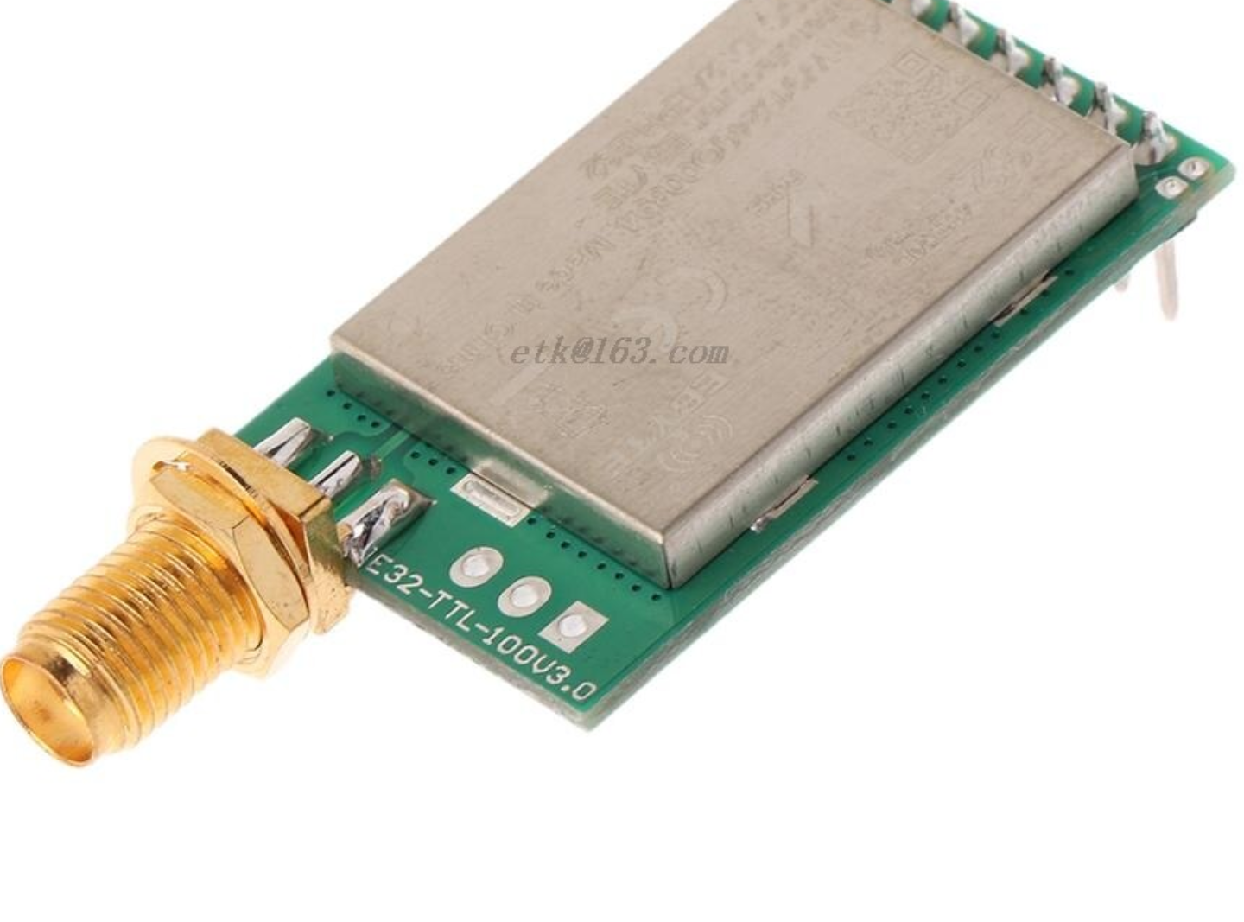
LoRa Device
Easy to install.
Small and lightweight.
Extremely economical.
Flexible to adapt.
Scalable
BI-Directional
Secure and Encrypted

Slide 7
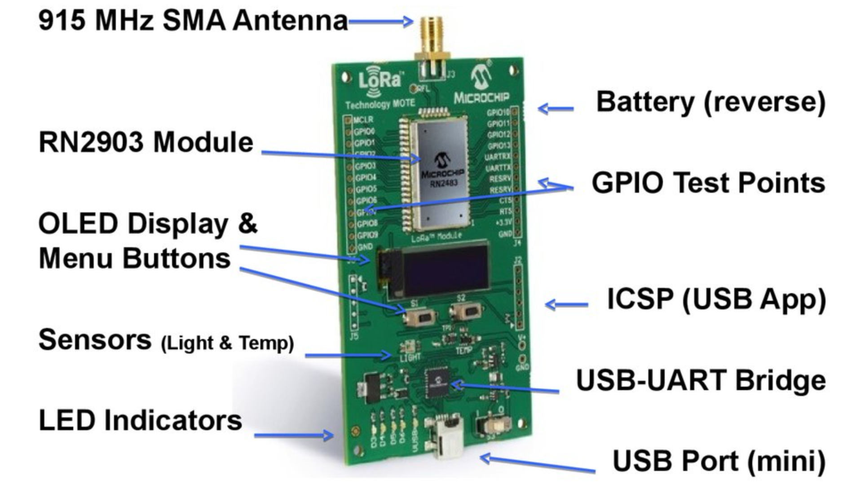

Slide 8
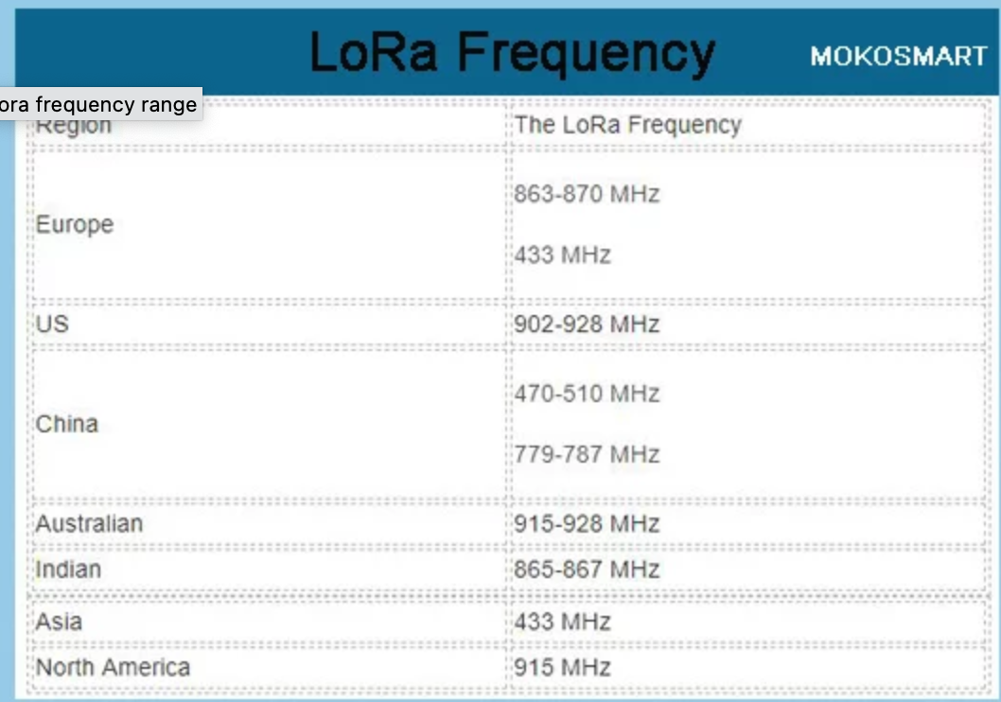
Israel – 915-917 MHz

Slide 9
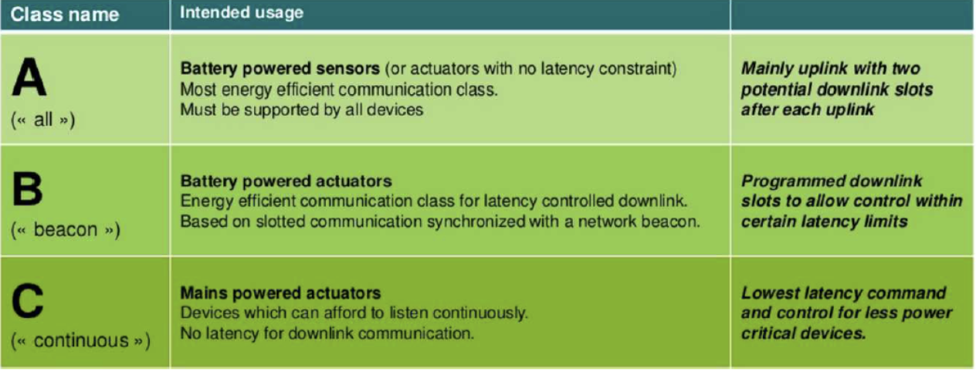
LoRa Classes End Devices:
Lora network composed of end devices and gateways. Based on MAC devices in LoRa network. The classes are defined as class A, class B and class C.
All the LoRa classes based end devices are bi-directional in nature for communication.

Slide 10
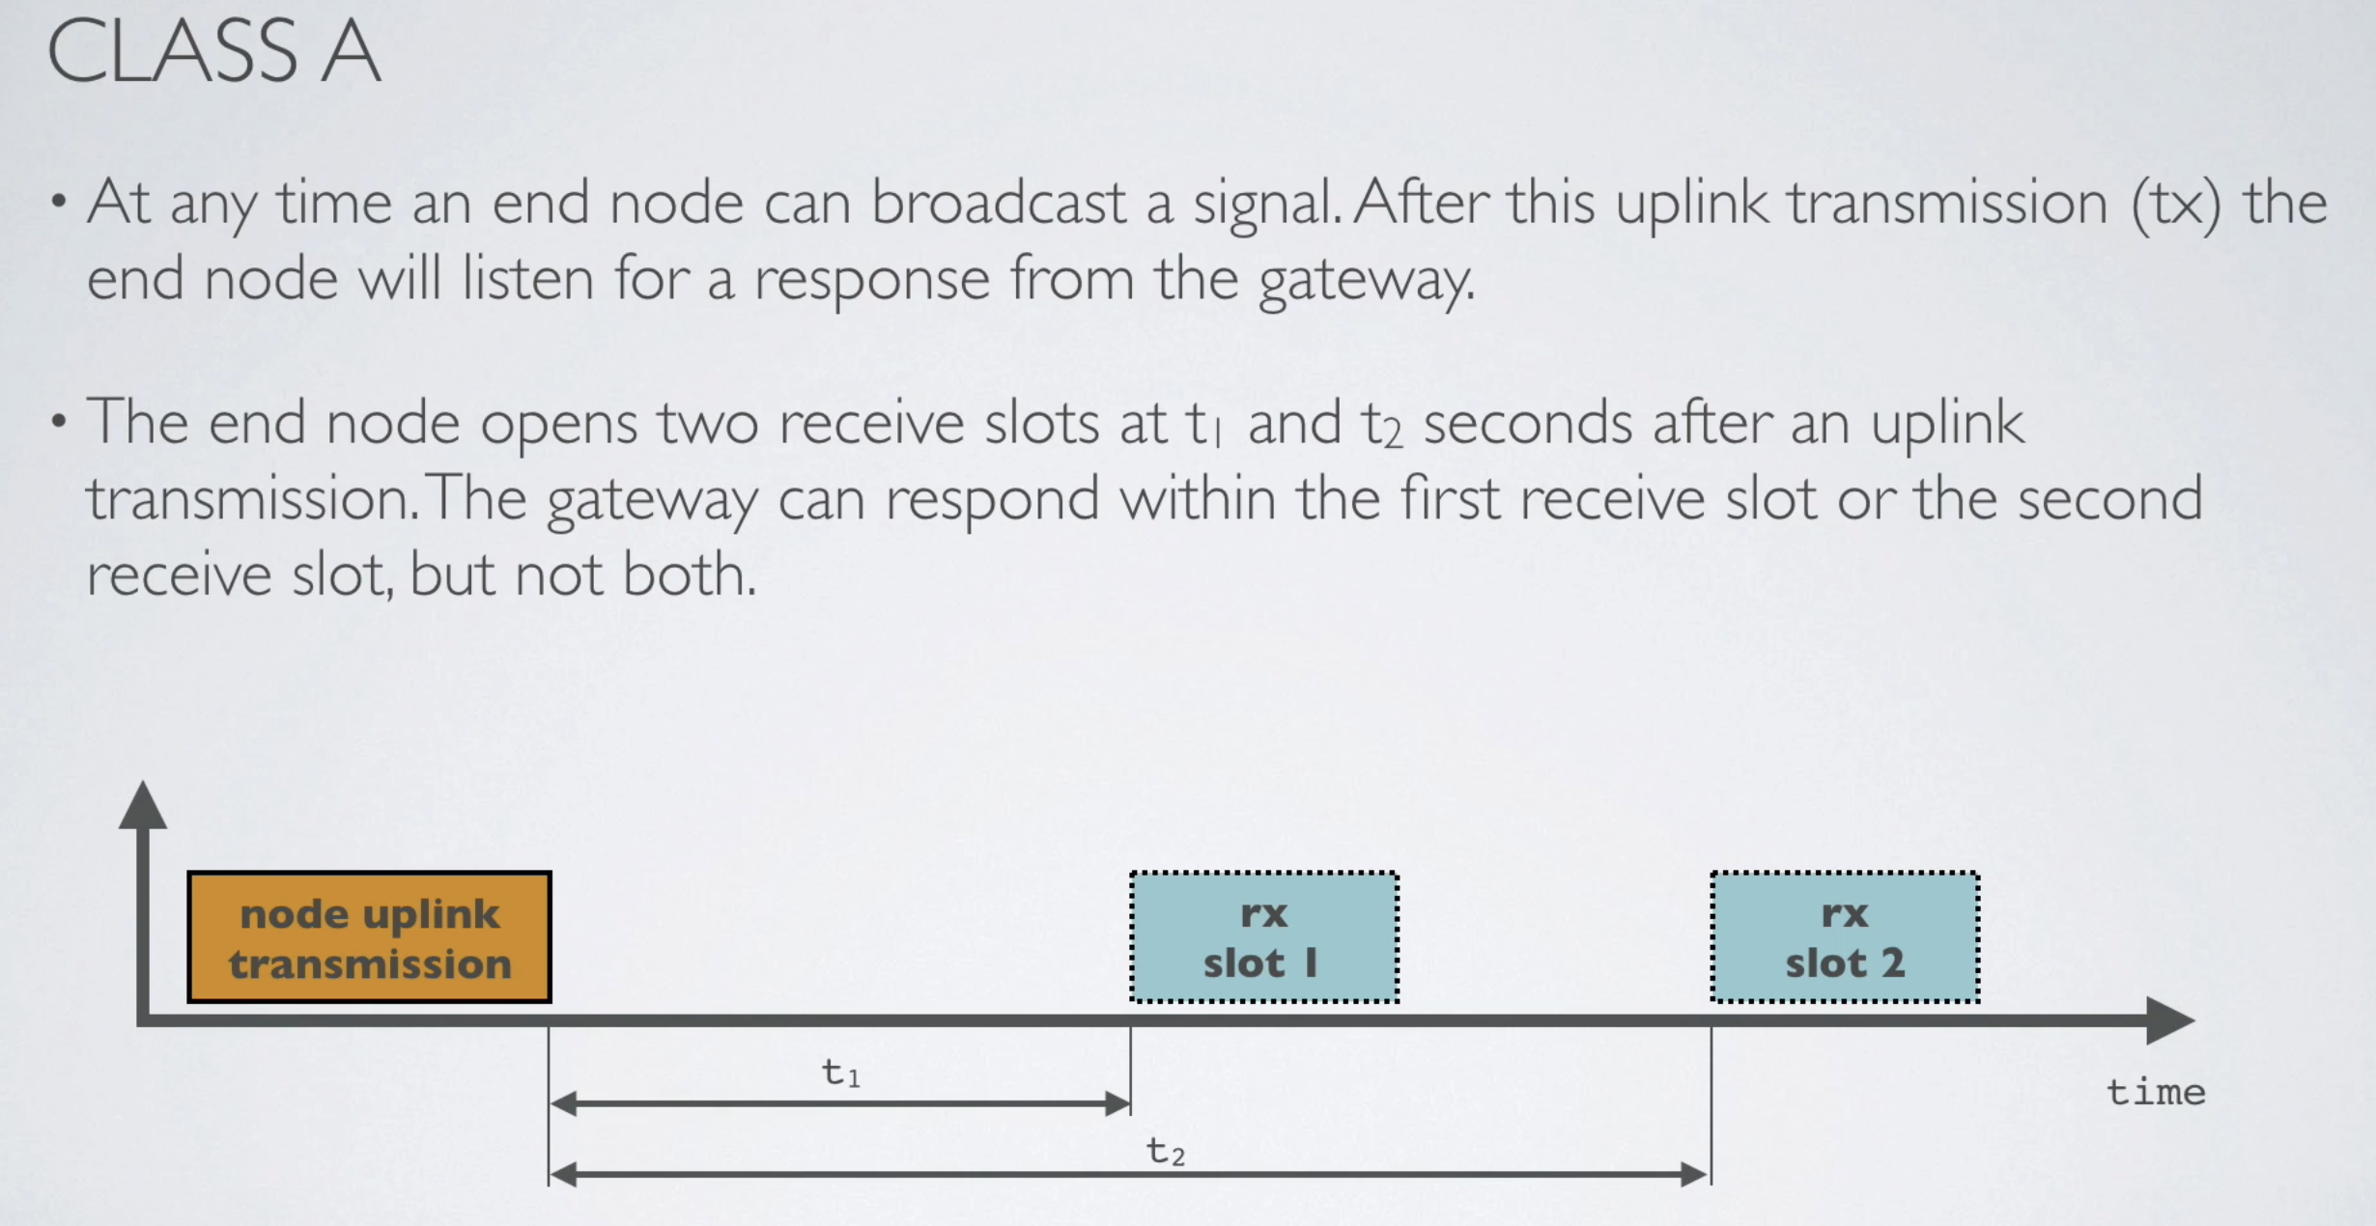
Class A

Slide 11
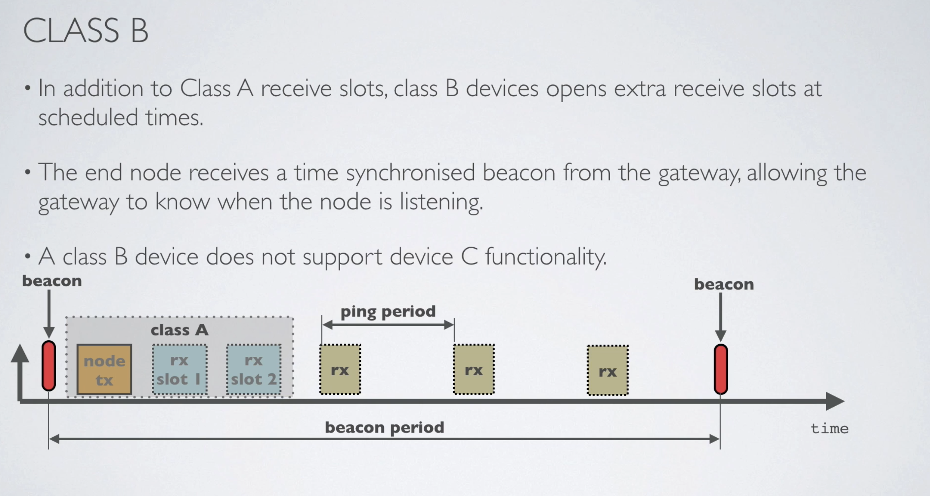
Class B

Slide 12
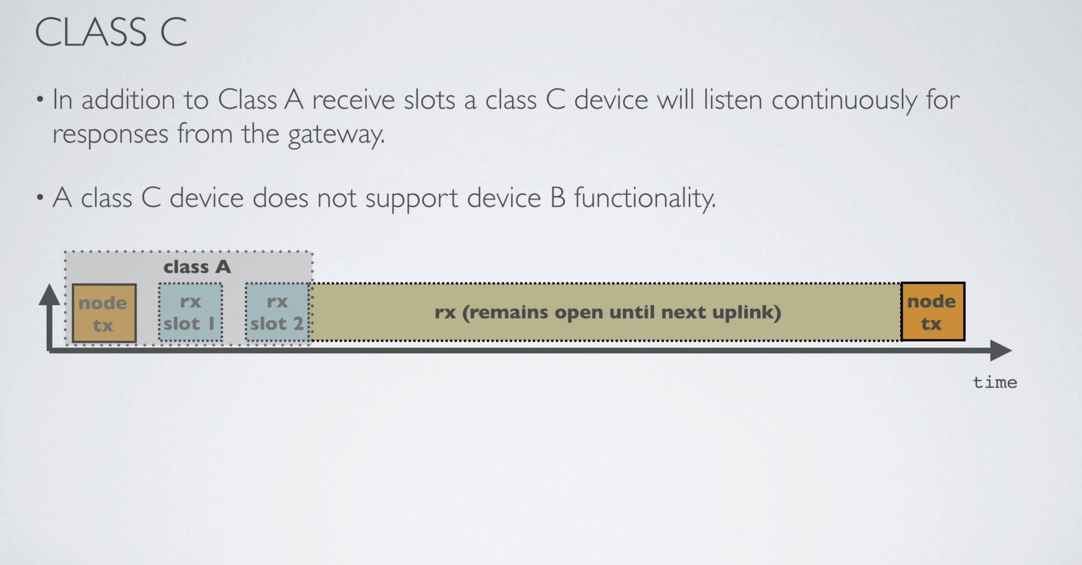
Class C

Slide 13
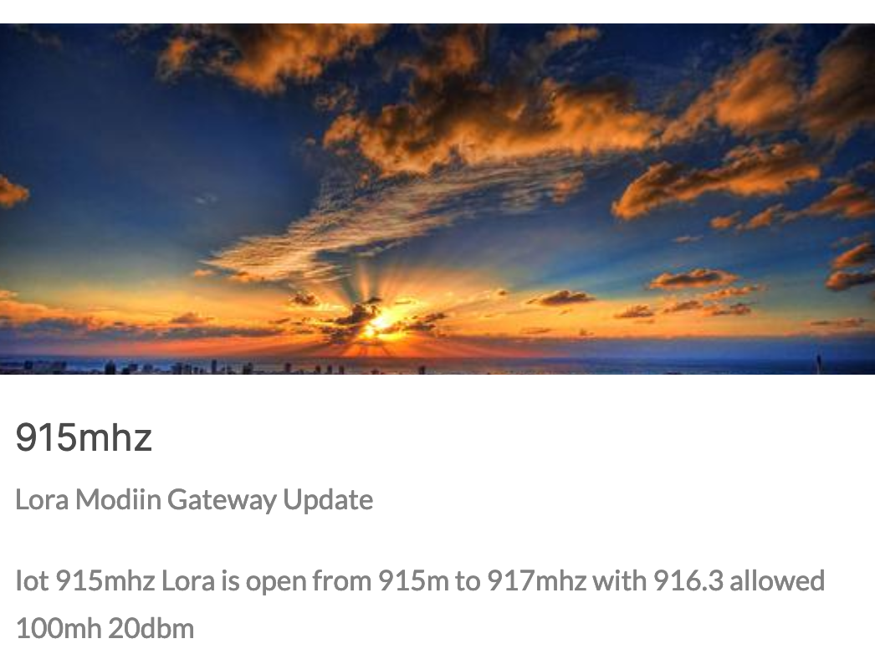
LoRa over the world
More than 14200 members
19455 Gateways
151 countries (include israel)

Slide 14
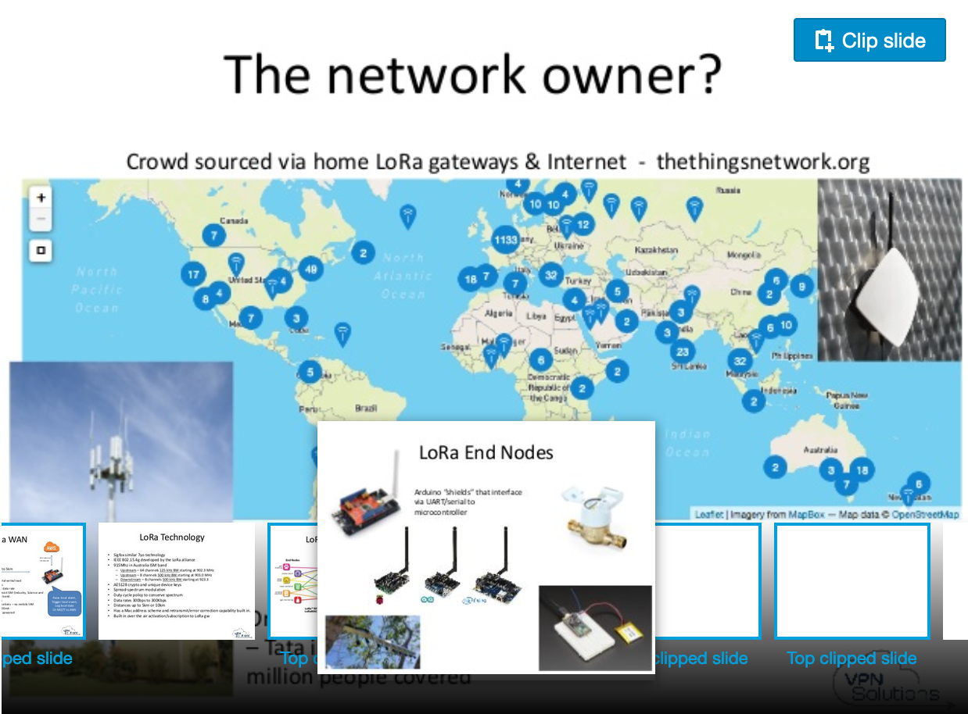

Slide 15
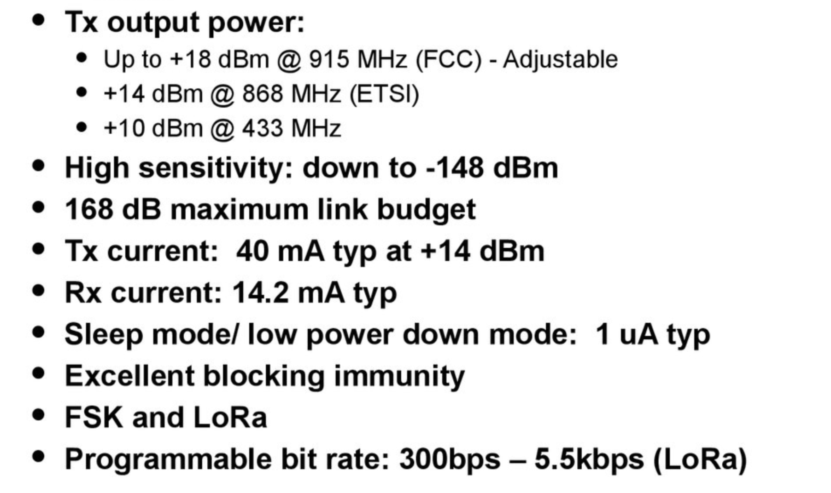
LoRa Modem RF Features

Slide 16
LoRaWAN Helped Fight COVID-19
As the COVID-19 pandemic continues to confront the world with unprecedented challenges, more governments and government institutions are sending calls for help to fight the Coronavirus. Several incredible members of the LoRa Alliance® ecosystem have stepped up to answer those calls by providing solutions, technology, tips and resources to help our communities during this challenging time. These solutions are viable, readily available, and in some cases already deployed to hard-hit areas of the globe.
For more information

